Slide 1
Thesis Defense Presentation
COVID-19 Vaccination Management System
Name: Rahiq Al Makhtum
ID: 2018511460013
Supervisor: Hu Dasha

Slide 2
Content Section
01
Introduction
02
System Module
03
Diagrams
04
Project Demonstrations
05
Future Scope & Conclusion

Slide 3
1.Introduction

Slide 4
The Covid-19 vaccination Management system is responsible for storing and managing the data of persons who are vaccine eligible. The vaccination can be distributed by the system
administration to those who require it. Vaccination is a delicate procedure, thus it must be
maintained and handled with extreme caution. In response to this worry, I created a new,
advanced, and well-designed vaccination registration system in which the administration can
easily manage the complete system module. With a user name and password, the administrator may quickly log in to the system. He also has the ability to change the password at any moment. The system can be given access to other new admins if the administration so desires.
The administration can add new patients after logging in. The administration also has complete
control over the patient's information, including the ability to update or edit it. If vaccine units are available on the system, the administration will capture them in the system database and profile
them with vaccine units based on their need.

Slide 5
Objective
The major goal of this vaccination management system is to store and manage all of the patient's data, as well as the available vaccine kinds in each shot. Additionally, provide it
to those who require vaccines in a more efficient manner. I've been attempting to
develop an effective communication mechanism between the patient, vaccination administration, and receivers. Other objectives include improving the operating system, reducing the number of employees, and eliminating the manual paper-based record-keeping method. In addition,
keep all of the information in one place, enhance the accuracy and consistency of the system,
and better management control policy, among other things.

Slide 6
Proposed System
Data Security
Ensure Data Accuracy
Minimize Manual Data Entry
User Friendly & Attractive

Slide 7
2.System Module

Slide 8
System Module
The major goal of this module is to give the patient access to all of the features. It keeps track of all of the patient's information and details. I designed all of the patient's CRUD (Create, Read, Update, and Delete) operations.
Patient module
This module's main goal is to provide all of Vaccine
Management's functionality. The Vaccines module is a critical component of this system. It keeps track of all vaccine information. Only the administrator has access to the Vaccine site,
and users can request to see if a vaccine is available.
Add Vaccine
This module's main goal is to provide all of the functionality relevant to vaccine kinds. It keeps track of all
vaccine data and information.
Vaccine module features include the ability to create ne Vaccine types and units, as well as the option to view a list of Vaccine availability. Only the administrator can change and delete Vaccine units.
Log in for admin
Forget password for admin
Edit profile for admin
Change password for admin
Log out functionality
Dashboard for admin
Add new Patient

Slide 9








Implementation Tool & Environment

Slide 10
3. Diagrams

Slide 11
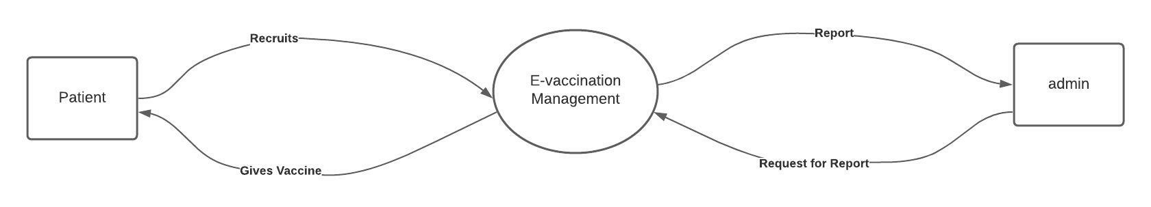
Data flow diagram
This is a high-level overview of the vaccine management system as a whole. The diagram is
frequently used as a first step in creating an overview of the vaccine management system without
delving too deeply into the details, which will be discussed later. Simply put, it is the vaccination
management information management system's overall dataflow and operations. In the graphic
below, data processing and organized design of the vaccine management information process and
working flow have been visualized.

Slide 12
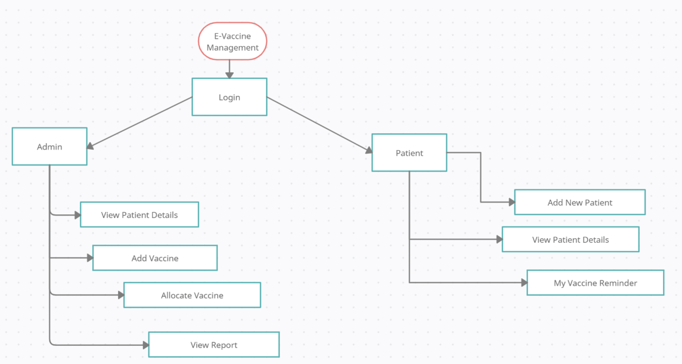
ER-diagram

Slide 13
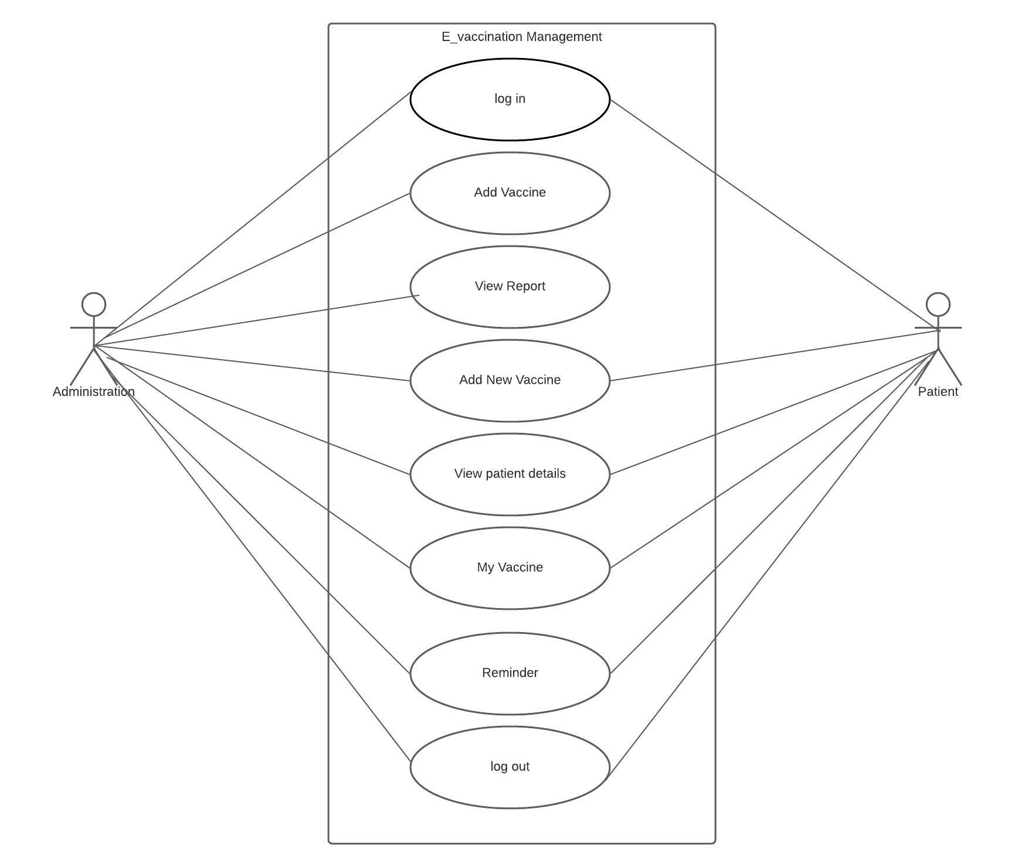
Use Case diagram

Slide 14
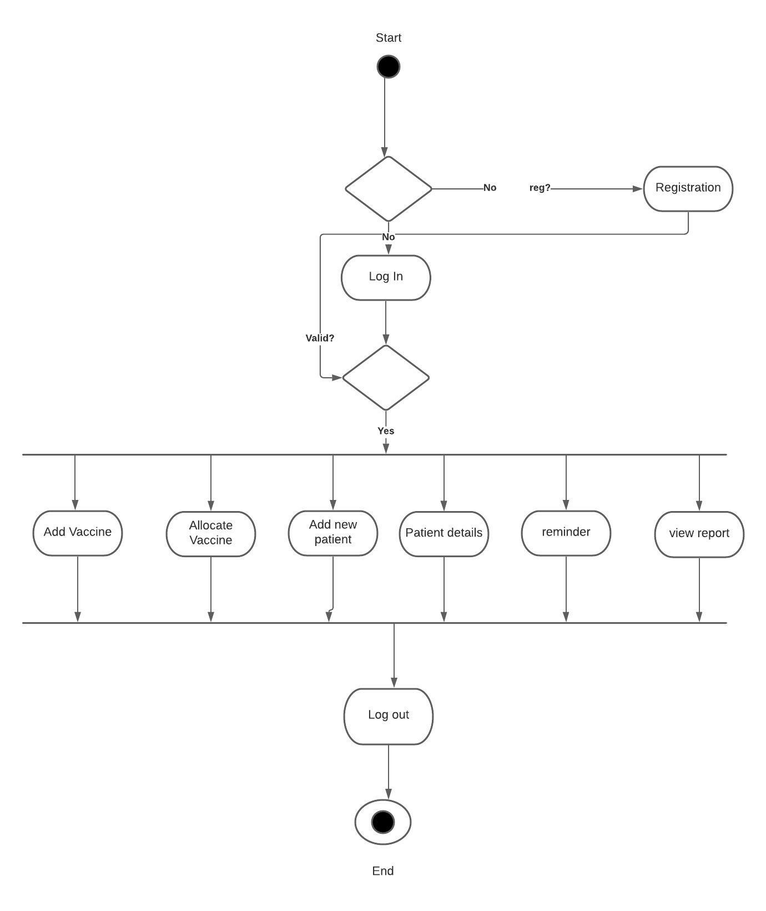
Activity diagram

Slide 15
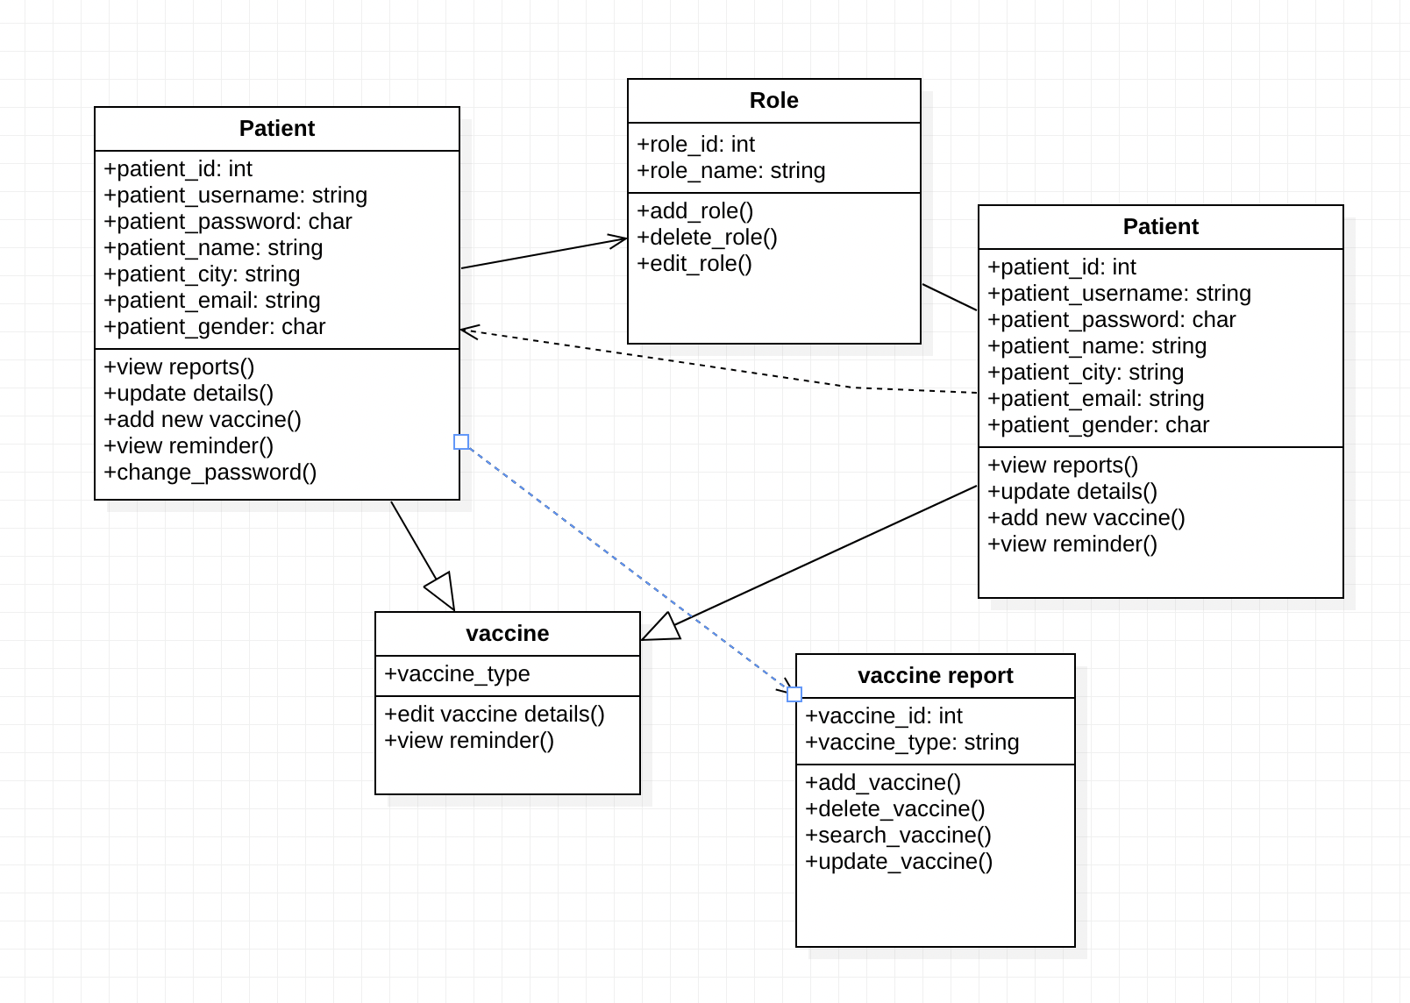
Data Class diagram

Slide 16
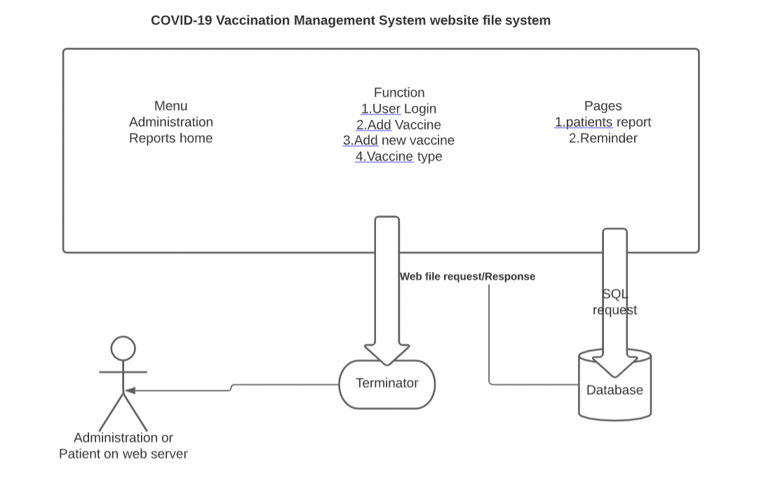
System Architecture

Slide 17
4. Project Demonstration

Slide 18
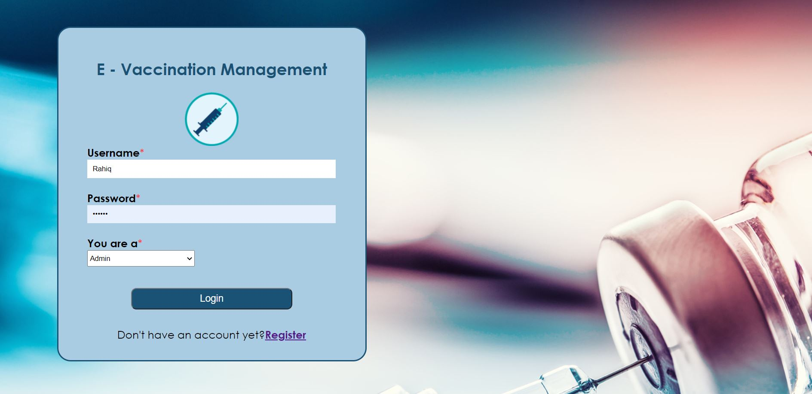
Log-In

Slide 19
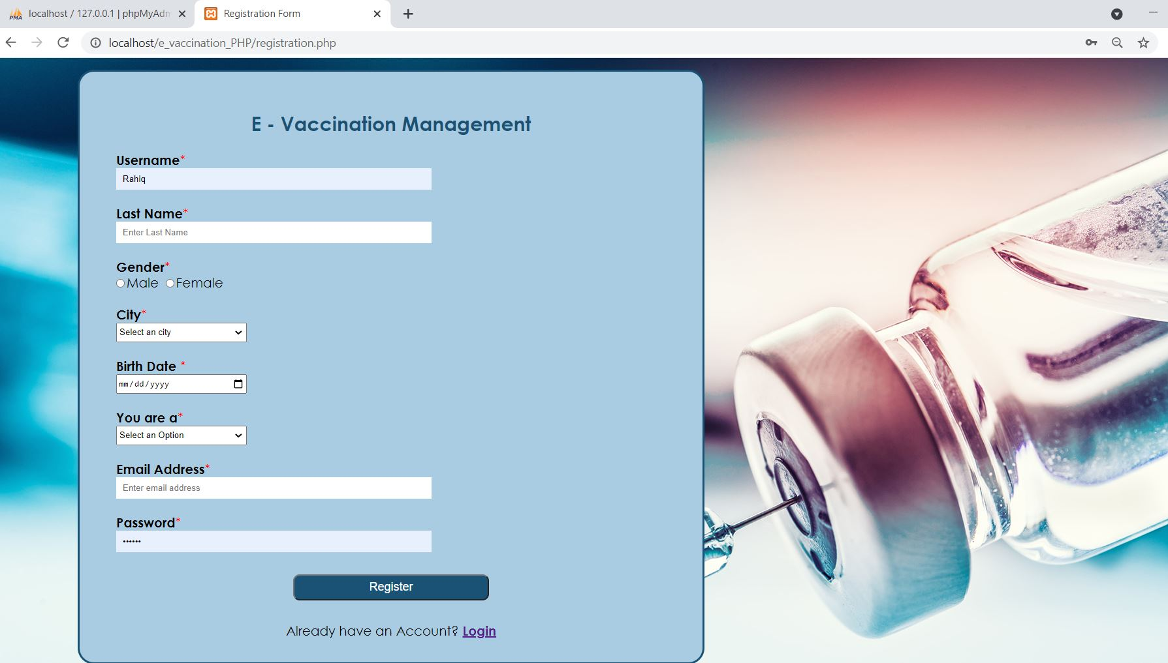
Registration

Slide 20
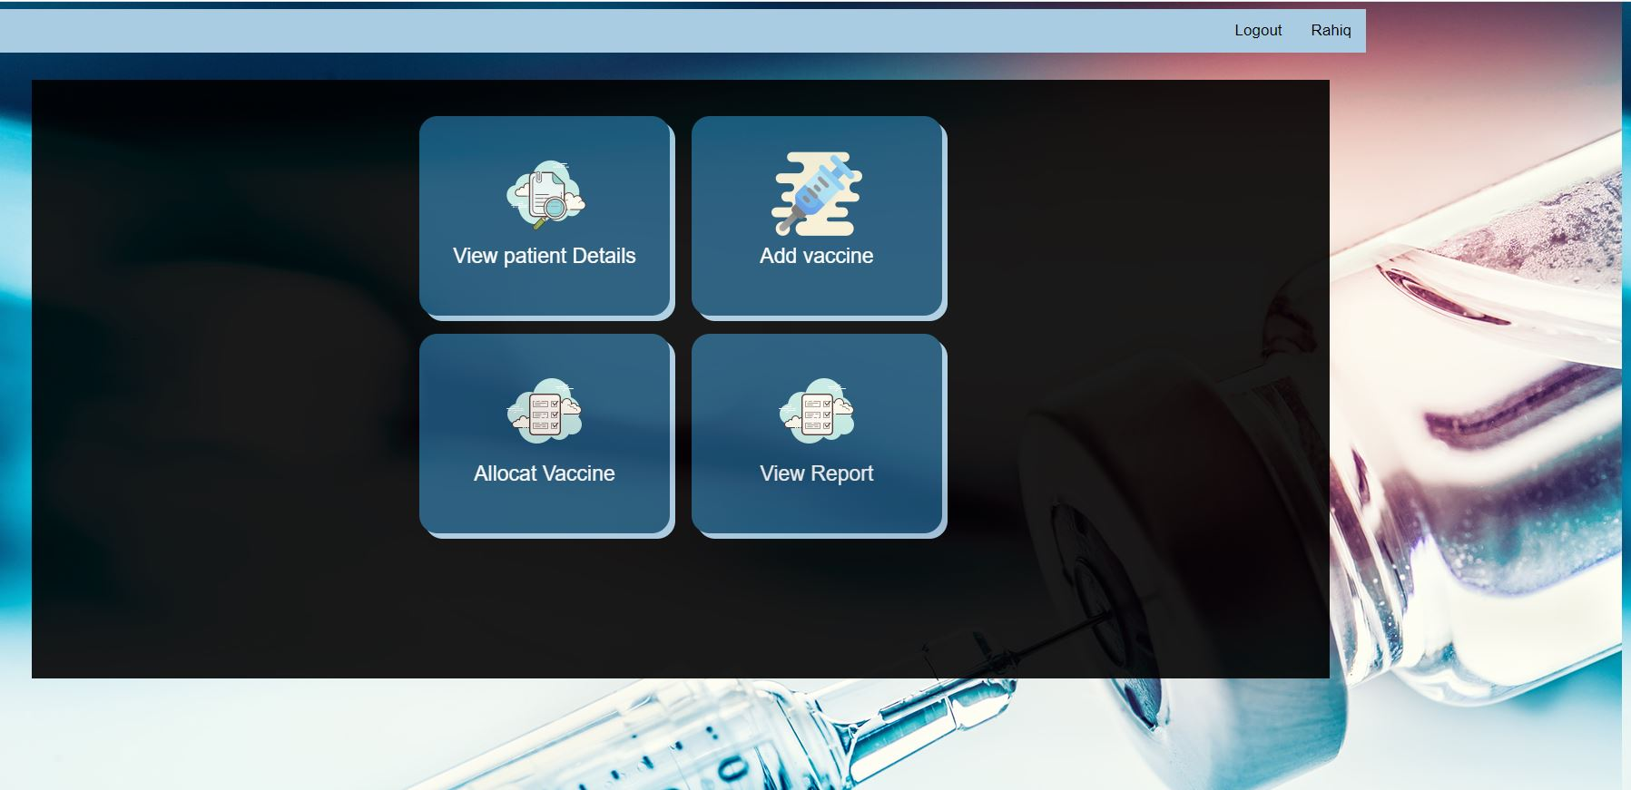
Admin Menu

Slide 21
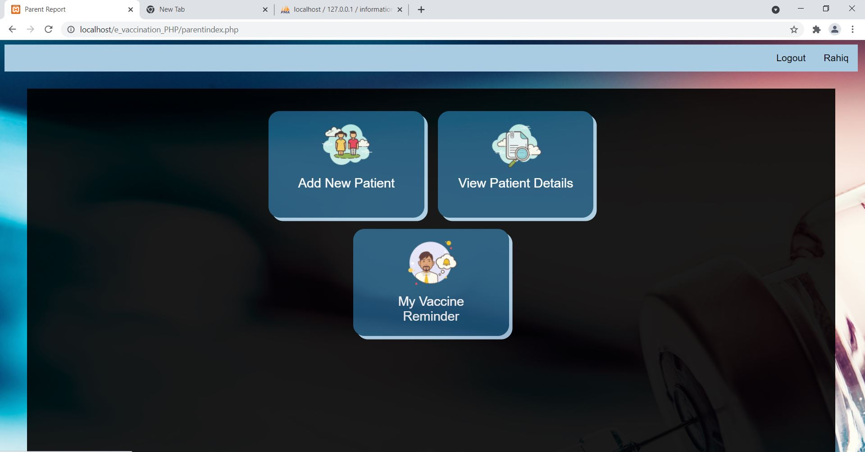
Patient Menu

Slide 22
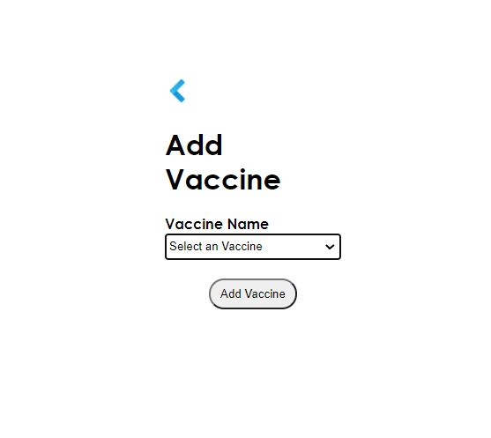
Add Vaccine

Slide 23
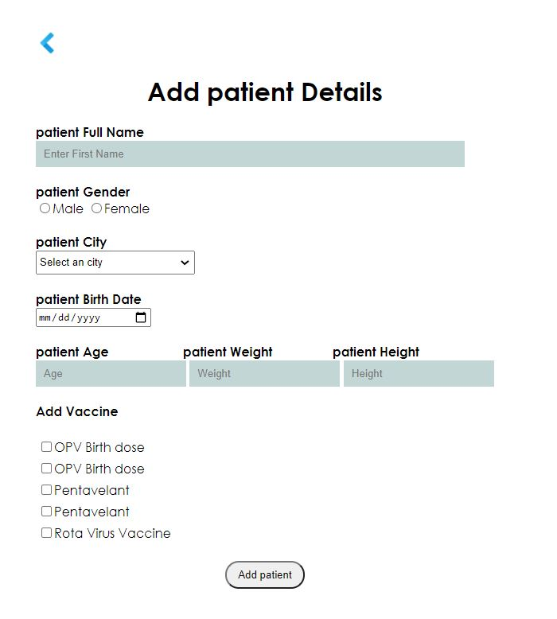
Add Patient Details

Slide 24
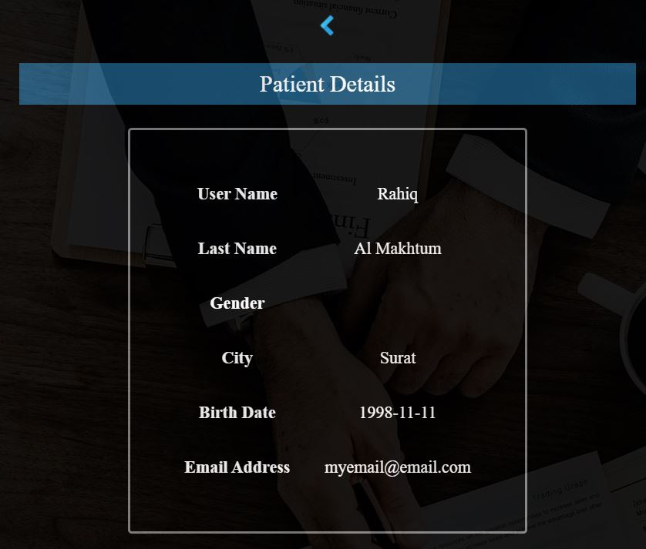
Patient Details

Slide 25
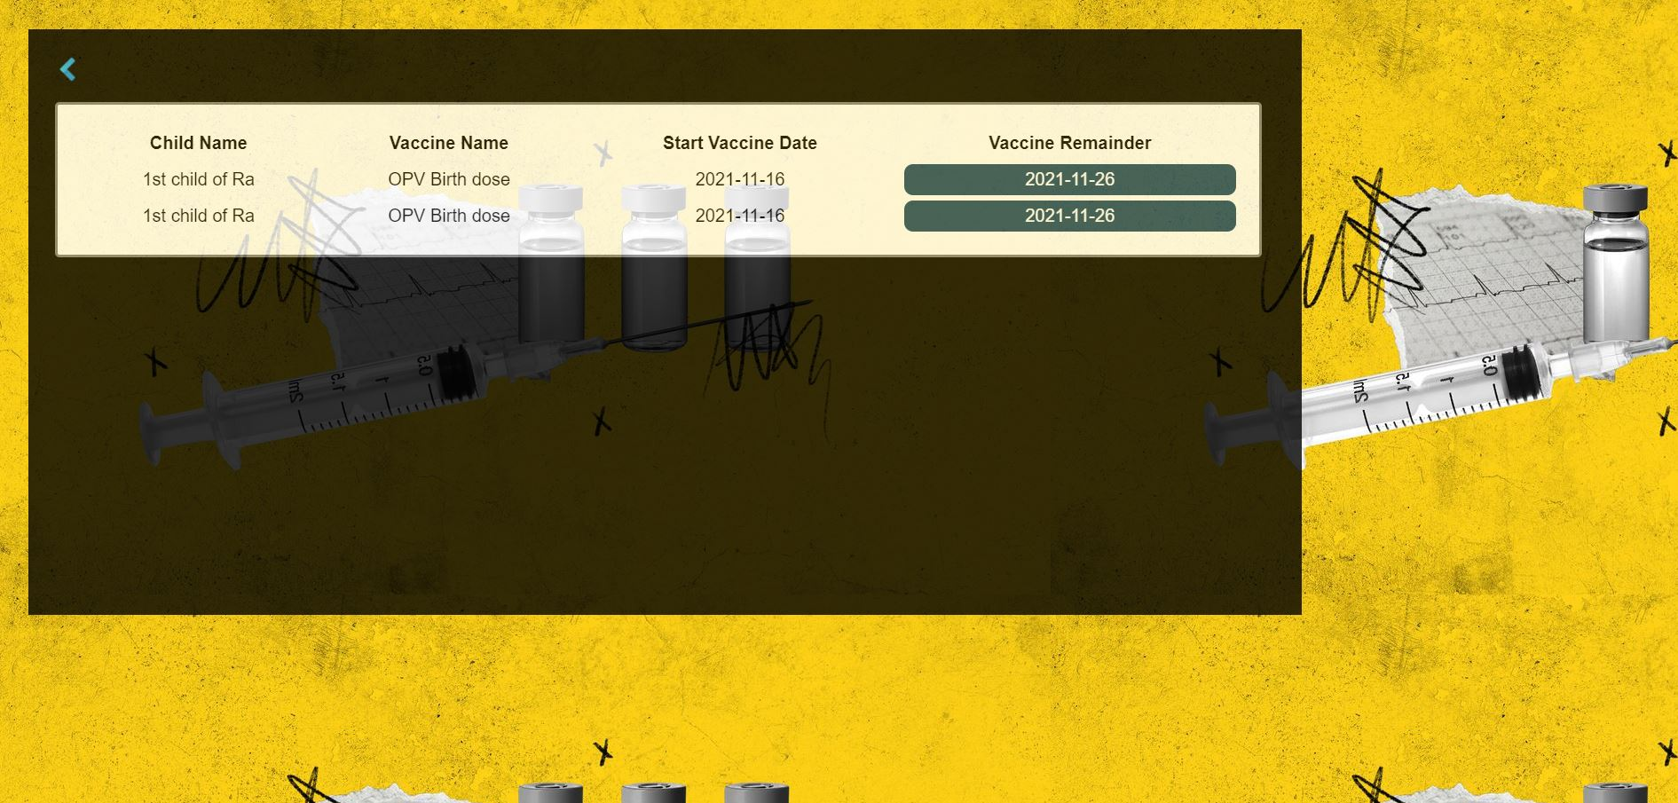
Vaccine Reminder

Slide 26
5. Future Scope & Conclusion

Slide 27
Future Scope
• Create a user for each patient and give them access to the system
• Make vaccine stock and vaccine reports public
• Provide access to hospital management
• Save patient information for future inquiries
• Add a search bar to the top of the menu bar

Slide 28
Conclusion
In today's world, online software is a must-have for everyone. It's quick, straightforward, and
simple to use. Our health has been the most crucial thing for us to take care of this year because there are so many severe diseases these days that may impact anyone regardless of age or
gender. As a result, many people will be forced to visit a hospital or other medical facility in
order to receive therapy or medicine for the sickness. However, Covid-19 cases have been fast increasing in recent days, making the situation much worse because the hospital will be
overburdened with Covid-19 patients. So this Online Covid-19 Vaccination Management
System will be more efficient for anyone living around the world in future.

Slide 29
Thank you
For giving me this opportunity to make this project happen

